Slide 1
National Military Association or Private Organization
As of 22 Mar 2021
Notes:
Good Morning

Slide 2
What is AFSA?
AFSA was founded in 1961 by four U.S. Air Force non-commissioned officers who recognized the need for an organization to represent the voice of all enlisted personnel to America’s elected and military leaders.
Over the past five decades, AFSA has built a reputation as a stalwart advocate for U.S. Air Force enlisted members and their families.
AFSA represents its members by advocating for its members’ interests, ensuring the military and veteran benefits its members earned through their service to the nation are maintained.
As a federally chartered Veteran Service Organization, AFSA is endorsed by U.S. Congress to represent military personnel and their families on Capitol Hill.

Slide 3
What is AFSA?
The Air Force Sergeants Association (AFSA) is a federally-chartered, Veterans’ Service Organization representing the professional and personal interests of our members, Total Forces and their families. AFSA is one of the few military associations able to lobby and provide face-to-face representation with our Nation’s Congressional and Military Leaders on Capitol Hill, and within the DoD and VA. The members are organized in 125 chapters throughout the world. The chapters provide professional development, opportunities for community involvement and a strong sense of fraternalism. AFSA’s mission is to advocate for improved quality of life and economic fairness that will support the well-being of all military personnel and their families. We represent over 750,000+ military members and their families. AFSA’s vision is to be the premier professional military and veterans service organization of choice for the enlisted corps and their families. AFSA’s Core Values: Integrity, Patriotism, Service, Professional Development, Friendship and Networking

Slide 4
AFSA Manuals & Reports
AFSAM 100-1 (Bylaws)
AFSAM 100-2 (Policies & Procedures)
AFSAM 100-3 (Standards for Officers)
AFSAM 100-4 (Daily Operations)
AFSAM 100-5 (Awards & Recognition Programs)
AFSA Form 700-5: “Activity, Americanism, and Financial (AAF) Report” (Quarterly)
AFSA Form 700-5(2): “Directory of Officers (DOO)” (Annual & Updated)
AFSA Form 700-5G: “AFSA Annual Budget” (Annual)
AFSA Form 700-5e: “Annual Field Audit Report” (Annual)
IRS Form W9: “Request for Taxpayer Identification Number and Certification” (Annual)

Slide 5
PO vs. NMA (AFSA)
Private Orgs | Feature | AFSA
n/a | Congressionally-Chartered National Military Association | Std
n/a | Recognized by Secretary of the Air Force & Chief of Staff of the Air Force | Std
n/a | 501(c)(19) Tax-Exempt Status | Std
n/a | Membership in The Military Coalition (TMC) | Std
n/a | Legislative Advocacy (Local, State, National) | Std
n/a | Inclusive Membership (All Ranks, All Services, All Status) | Std
Opt | Life Membership | Std
n/a | Transferable Membership | Std
Std | Mentorship, Professional Development Opportunities | Std
Std | Leadership, Management Opportunities | Std
Std | Community Outreach & Engagement | Std
n/a | Business Community Support (Chamber of Commerce Membership) | Opt
n/a | Continuity of Effort (Chapter Senior Advisor, Division & International Support) | Std
n/a | Annual Professional Airman’s Conferences (Division & International) | Std
n/a | Communications with the Office of the Chief Master Sergeant of the Air Force | Std
n/a | Annual Testimony to Congress | Std

Slide 6
PO Defined
AFI 34-223 Private Organization Program (extracts)
Section 5 Installation Commander:
5.1. “Is the approval authority for establishment of Private Organizations when he/she determines they will make a positive contribution to the quality of life of base personnel. Approval authority and below actions may be delegated to Mission Support Group Commander (MSG/CC).”
5.2. “Will withdraw authorization if the Private Organization prejudices or discredits the United States Government, conflicts with Government activities, or for any other reason or just cause.”
Section 6 Force Support Squadron Commander/Director:
6.1. “Will ensure membership provisions and startup justification continue to apply.”
6.2. “Will advise the installation commander on Private Organization changes, to include a recommendation to revoke or continue permission to operate.”
Section 7 Force Support Resource Manager or Resource Management Flight Chief:
7.1. “Will maintain a file on each installation Private Organization.”
7.2. “Will annually review the Private Organization’s folder to ensure financial statements, documents, records, and other information as required this Instruction and the Private Organization guide are in order.”

Slide 7
Why Be an NMA?
Use of “Air Force” in our name:
AFI 34-223, Section B10.1.2.1: “Private Organizations must have written approval from the Installation Commander before using the name or abbreviation of the installation or organizational unit. Requests for use of the Department of Defense or Air Force name or abbreviation must be routed to the Air Force Services Activity, AFSVA/SVI, for action.”
AFSA Manual 100-1, Bylaw 1, Section 1: “NAME. The organization name shall be the Air Force Sergeants Association Inc. (hereinafter referred to as AFSA), a nonprofit corporation incorporated in the District of Columbia.”
Dissolution of a Chapter:
AFSA Manual 100-4, Principal 5, Sections 3, 4, 5, 14, AFSA Manual 100-1, Bylaw 12, Section 9: “If, for any reason, the majority of the members of an active chapter desires the voluntary deactivation of their chapter, a special meeting shall be held and a vote taken and made a matter of record in the minutes of such meeting. The same actions apply as for revocation of charters as stipulated in Section 6.”

Slide 8
Why Be an NMA?
AFSA Chapter off-base fundraising:
AFI 34-223, Section B10.11: “….. Private organizations and unofficial activities should consult with their local Force Support POC and the local installation Judge Advocate before engaging in fund raising off the installation. (Still only limited to 3/quarter)”
AFSA company endorsements (USAA, Pearl, etc.)
AFI 34-223, Section B10.13: “POs and unofficial activities/organizations operating on an Air Force installation are prohibited from engaging in any conduct which has the effect of advertising for, making referrals to, or encouraging use of any commercial business concerns.”
AFSA Chapter Serve/Sell Alcohol:
AFI34-223, Section B10.14: “Private organizations will not sell or serve alcoholic beverages on Air Force installations. EXCEPTION: At the discretion of the installation commander, Non-Appropriated Fund Instrumentalities-operated Morale Welfare and Recreation programs may secure the aid of volunteers or persons providing gratuitous services to assist in the sale of Morale, Welfare and Recreation-procured alcoholic beverages.”

Slide 9
Why Be an NMA?
Chapter use of AFSA funds for AFSA-related activities:
AFI 34-223, Section B10.20.4: “Raffles may not be authorized to raise money for an outside cause local or national group, such as local regional or national charities (including the Combined Federal Campaign).”
AFSA Manual 100-4, Principle 7 Section 2: “The following categories comprise
accepted uses of support payment funds: 1) Divisions/Chapters award and
recognition programs; 2) Contributions and donations to functions supporting the
Wing or external veteran’s community; 3) Fund raising costs; 4) Key personnel travel
to Division/International conferences, meetings, events, etc.; 5) Office and
administrative supplies; 6) Divisions/Chapters social events that add value to the
Association; 7) Activities designed to assist in Divisions/Chapters recruiting and
retention; 8) Activities designed to support Divisions/Chapters legislative programs
9) Activities designed to enhance Divisions/Chapters communications to include
newsletters, websites, social media, etc.”

Slide 10
Private Org vs. NMA
IAW AFI 34-223 is an AFSA Chapter a Private Organization?
Installation Commander Approves Establishment? (Y/N)
Installation Commander Withdraws Establishment? (Y/N)
FSS Commander Ensures Justification Still Exists? (Y/N)
FSS Commander Recommends Revocation/Renewal? (Y/N)
FSS RM Maintains a File? (Y/N)
FSS RM Annual Review of Financial Records, etc.? (Y/N)
As an NMA
the answers are all “no”…

Slide 11
Where We Were
AFSA Manual 100-4 – Principle 5, Section 1.
Used to Say…….
“a. The Air Force Sergeants Association is a Professional Military Association and Veteran Service Organization, formally chartered by Congress. There are elements of each chapter that must follow the rules of private organizations while on a military installation. Air Force Instruction 34-223 prescribes requirements for private organizations located on Air Force installations. AFSA Chapter Presidents affected should obtain a copy of this document from the appropriate location.
b. As local affiliations of a veteran’s organization, AFSA chapters are classified as private organizations, as defined in this instruction. As such, these chapters operate on an Air Force installation with the consent of the Installation Commander. An annual review is made by the local base military officials to see if the bylaws, policies and procedures, etc., prescribing membership provisions and purposes, still apply, and to determine whether the chapter’s authorization to operate shall be continued.”

Slide 12
Where We Were
Chapter 951 experienced years of issues/roadblocks
FSS/JA wanted “control” (approval) of chapter’s off -base activities
AFSA “not exempted” in AFI 34-223, Section A.2. Applicability
Told use of “Air Force” in Air Force Sergeants Association was illegal
Told must register as a PO in order to meet on base
2014 AFSA International President visits Ellsworth AFB to see issues “first hand”
Unable to hold informational Earned Benefits briefings during duty hours at any duty location
Earned Benefits briefing approved for base theater on Friday at 1600 hours
No Public Affairs support/advertisement
Total audience (5)
AFSA International President & HQ Staff engaged with DoD/USAF to resolve

Slide 13
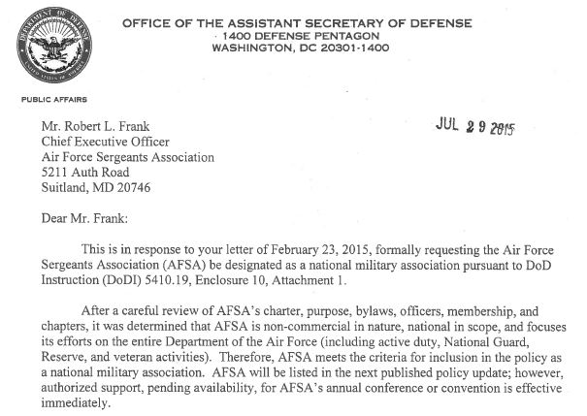
Where We Are
AFSA designated as NMA in DODI 5410.19, 29 Jul 2015

Slide 14
Where We Are
AFSA Manual 100-4 – Principle 5, Section 1.
Now Says…….
“a. The Air Force Sergeants is a Professional Military Association and Veteran Service Organization, formally chartered by Congress and recognized in DoD Instruction (DoDI) 5410.19 as a national military association.
b. As local affiliation of a veteran’s organization, AFSA chapters are classified as a national military association, as defined in DoDI 5410.19. Air Force Leadership has authorized, on occasion, assistance in disseminating information about Chapter's activities and/or logistical support for their events and programs. Chapters are required to seek approval of the Installation Commander to operate on the installation and to request the services defined in the DoD instruction.”

Slide 15
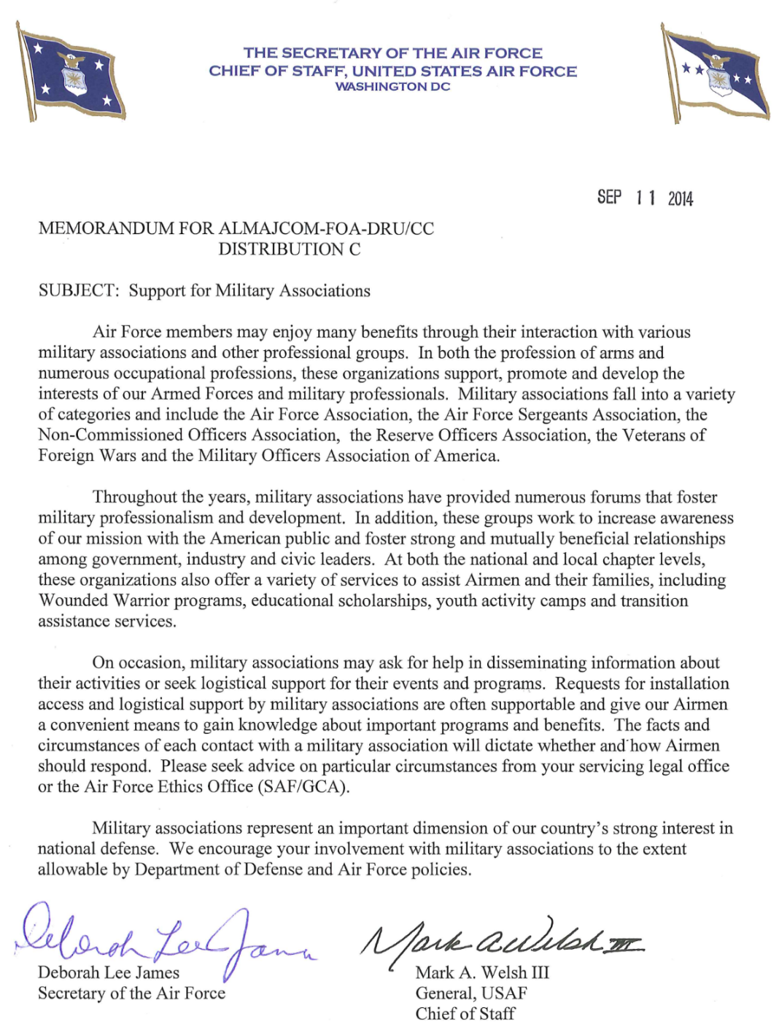
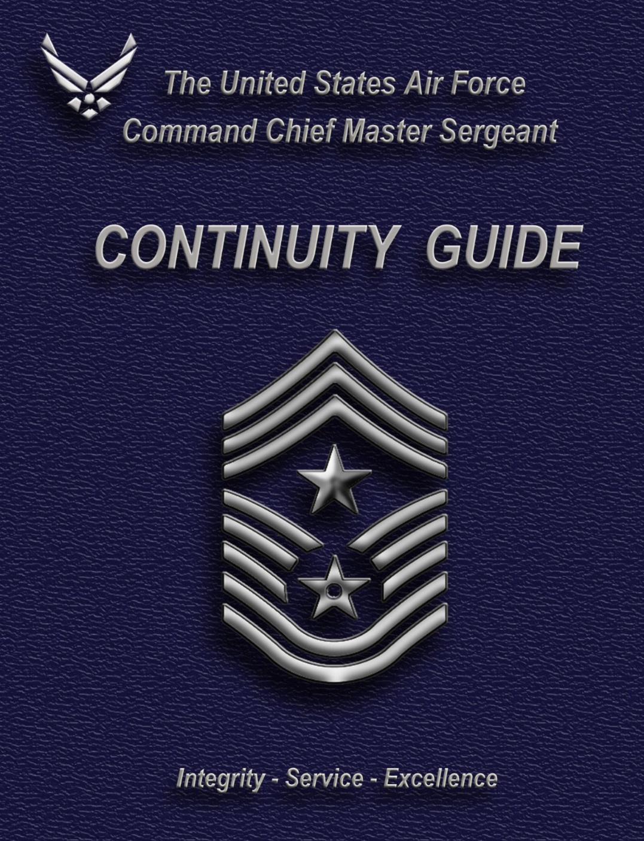
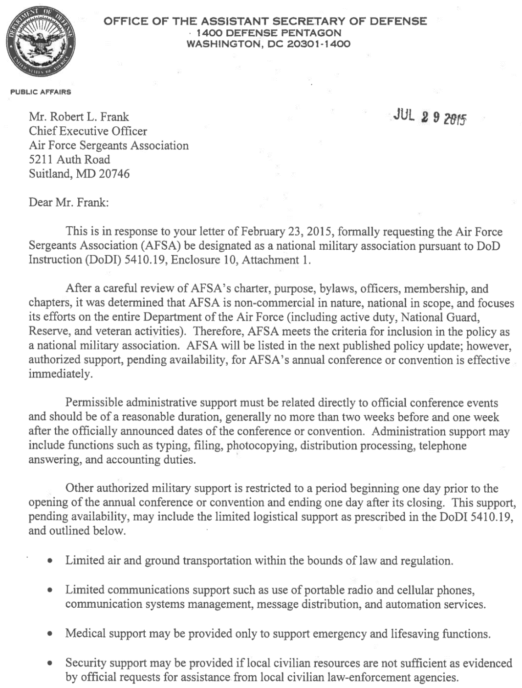
Supporting Documents www.hqafsa.org (Member Login, Chapter EPA)
SECAF/CSAF Letter, 2014
Secretary of Defense Letter, 2014
NMA Letter to AFSA, July 2015
DODI 5410.19, Enclosure 10, Att 1
DOD 5500.07-R (JER), Section 3-211
DODD 1000.26E (4.3, support for events/fundraising)
Command Chief Guide: 12, 20, 43, 74,

Slide 16
How to Affiliate as an NMA
1) Review the entire NMA package to understand policies
a) Discuss NMA vs PO Affiliation w/ Chapter Members
b) Eases Administrative Burden / Eases Movement
2) If Chapter desires NMA Affiliation with Installation
a) Discuss with Command Chief
b) Will not decrease Chapter support to Base & Community
3) Work with JAG to draft your chapter’s Letter of Agreement*
a) Staff Summary Sheet/Package for Wing CC Approval
b) Supporting Documents (NMA Package / AFSA Bylaws)
c) Letter to Dissolve base PO Affiliation
*Recommend multi-year Letter of Agreement

Slide 17
Pro Tips
Get away from using .mil or .gov emails….ALL MEMBERS!
On occasion you might need to use .mil or .gov email…if so DO NOT use your normal military signature block. Create an alternate signature block such as:
John Doe President, AFSA Chapter 111 (123) 456-7890 (cell) www.hqafsa.org
AFSA is a National Military Association, a tax-exempt post or organization of past or present members of the Uniformed Services. It is not a part of the Department of Defense or any of its components and it has no government status.
Also use the same disclaimer statement at the bottom of letters, flyers, posters, etc.:
AFSA is a National Military Association, a tax-exempt post or organization of past or present members of the Uniformed Services. It is not a part of the Department of Defense or any of its components and it has no government status.

Slide 18
Where You Are
NOW YOU ARE A RECOGNIZED NATIONAL MILITARY ASSOCIATION

Slide 19
QUESTIONS
Notes:
Thank you for your time and attention today.
Questions.

